Slide 1
CS 316: Introduction to Deep Learning
SoftMax Regression
Week 6
Dr Abdul Samad

Slide 2
Lecture Outline
Regression vs Classification
Multiclass Classification
Network Architecture
One-hot Encoding
Softmax
Cross entropy loss

Slide 3
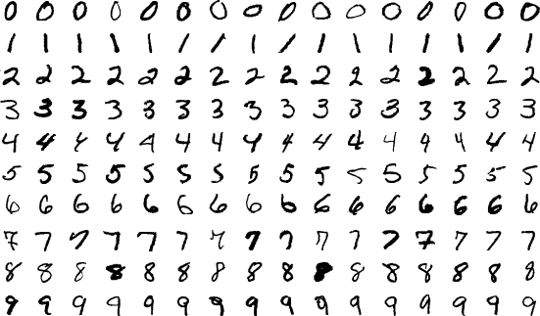

Regression vs Classification
Regression estimates a continuous value
Classification predicts a discrete category
MNIST: classify hand-written digits (10 classes)
ImageNet: classify nature objects (1000 classes)
Figures taken from MNIST Digits Dataset , ImageNet Dataset

Slide 4
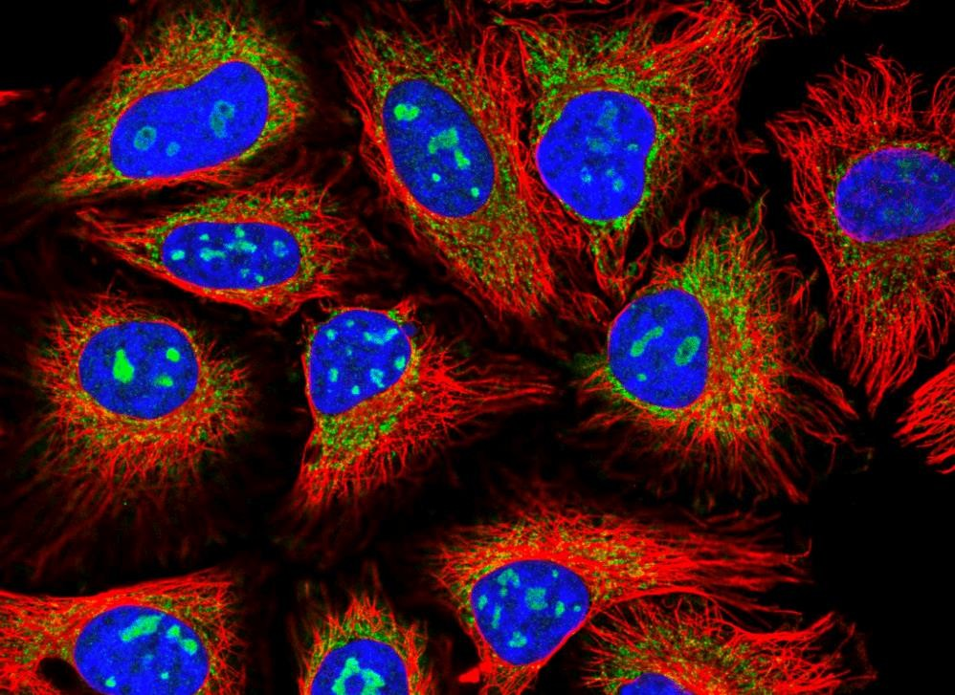
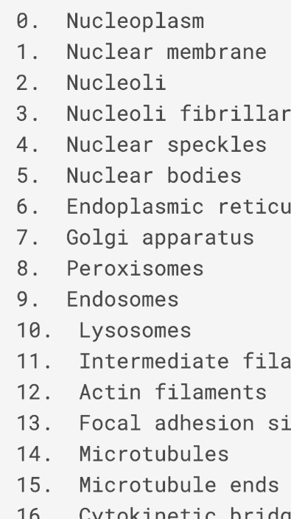
Classification Tasks at Kaggle
Classify human protein microscope images into 28 categories
Figure taken from Human Protein Atlas Image Classification

Slide 5

Classification Tasks at Kaggle
Classify malware into 9 categories
Figure taken from Malware Classification

Slide 6
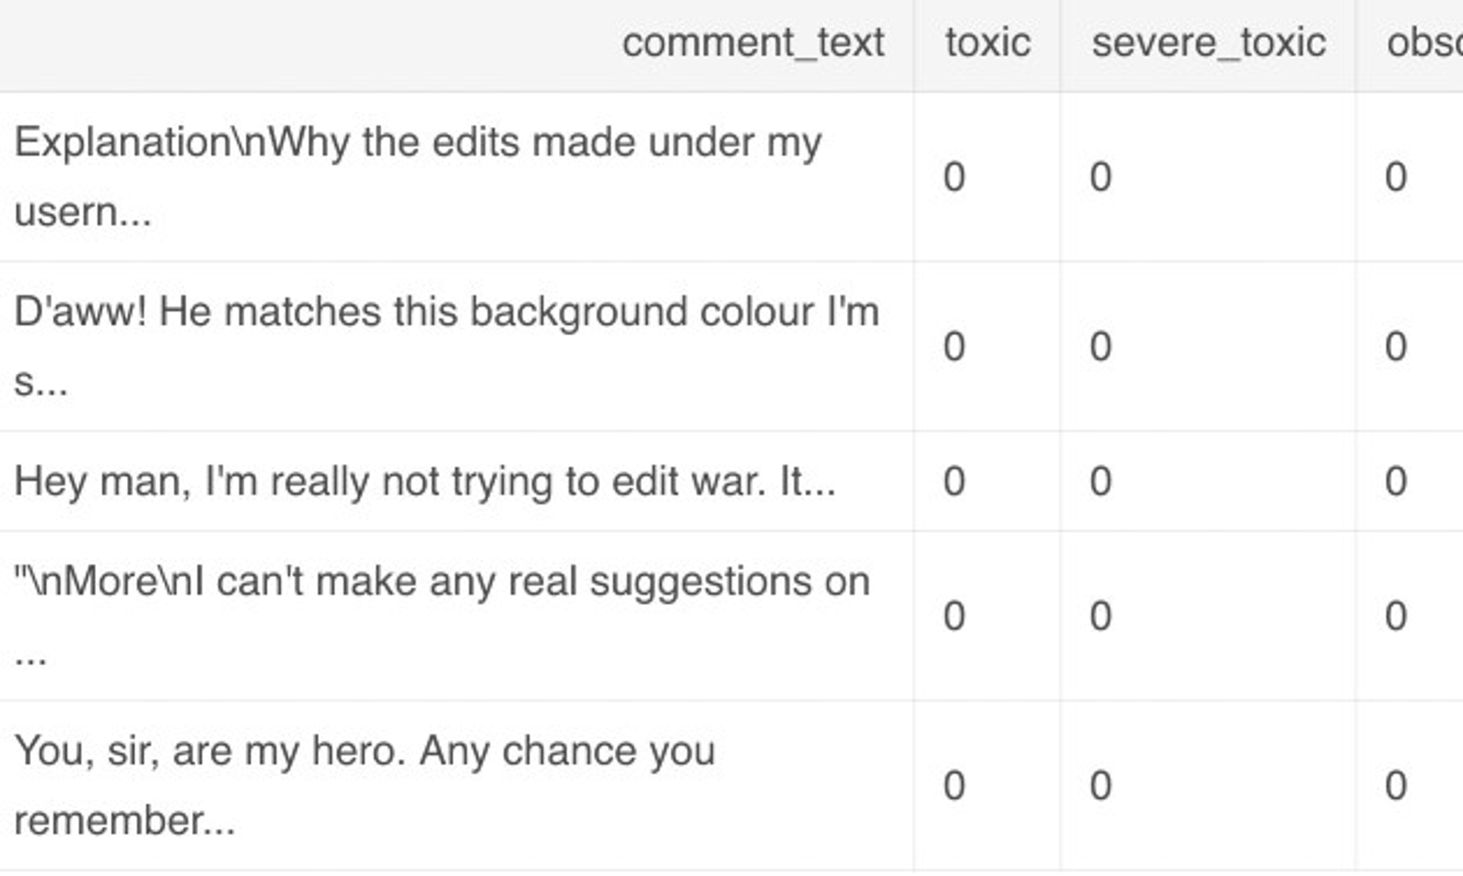
Classification Tasks at Kaggle
Classify toxic Wikipedia comments into 7 categories
Figure taken from Jigsaw Toxic Comment Classification Challenge

Slide 7
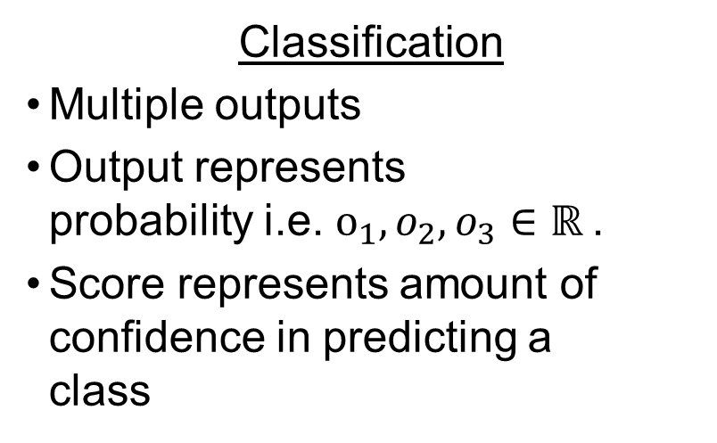
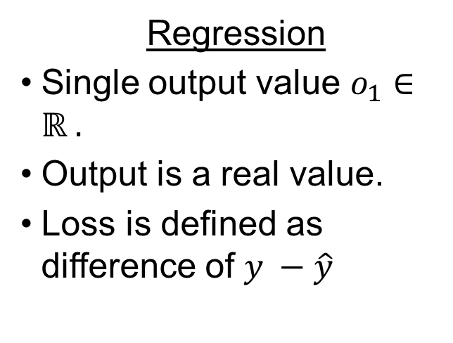
Multi-class Classification
Regression
Single output value $o_{1}∈ℝ$.
Output is a real value.
Loss is defined as difference of $y −\hat{y}$
Classification
Multiple outputs
Output represents probability i.e. $o_{1}, o_{2}, o_{3}∈ℝ$.
Score represents amount of confidence in predicting a class
Figures taken from Linear Regression , SoftMax Regression

Slide 8
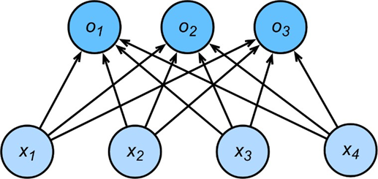

Network Architecture
$$o_{1}=x_{1}w_{11}+x_{2}w_{12}+x_{3}w_{13}+x_{4}w_{14}+b_{1}$$
$$o_{2}=x_{1}w_{21}+x_{2}w_{22}+x_{3}w_{23}+x_{4}w_{24}+b_{2}$$
$$o_{3}=x_{1}w_{31}+x_{2}w_{32}+x_{3}w_{33}+x_{4}w_{34}+b_{3}$$
$$o=Wx+b$$
Figure taken from SoftMax Regression

Slide 9
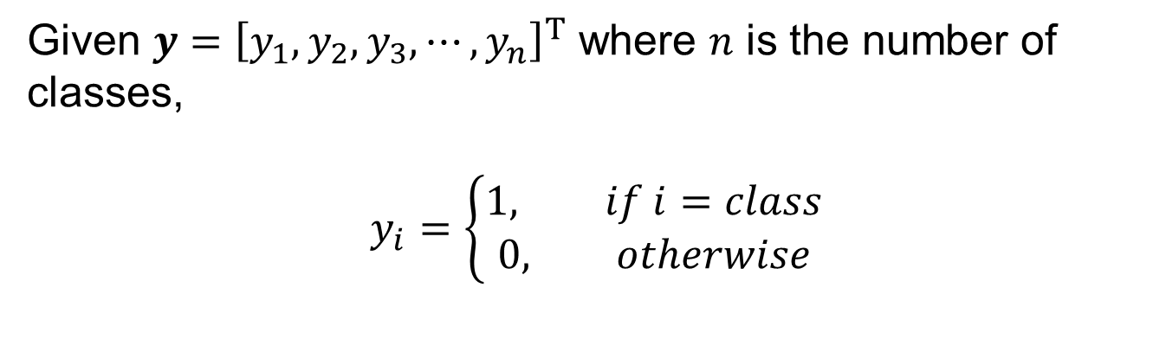
One-hot Encoding
Given $y={\left[y_{1}, y_{2},y_{3}, ⋯, y_{n}\right]}^{T}$ where $n$ is the number of classes,
$$y_{i}=\left\{\begin{aligned}1, if i=class \\ 0, otherwise\end{aligned}\right.$$

Slide 10
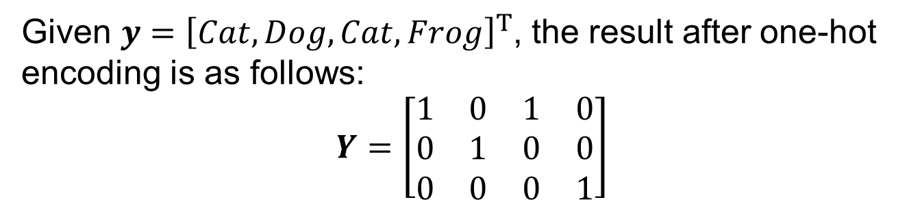
One-hot Encoding - Example
Given $y={\left[Cat, Dog, Cat, Frog\right]}^{T}$, the result after one-hot encoding is as follows:
$$Y=\left[\begin{matrix}1 & 0 & 1 & 0 \\ 0 & 1 & 0 & 0 \\ 0 & 0 & 0 & 1\end{matrix}\right]$$

Slide 11

SoftMax
Model output can be interpreted as probabilities.
Optimize the parameters to generate probabilities that maximize the probability of the observed data.
$\hat{y}=softmax\left(o\right)$
$\hat{y_{i}}=\frac{\exp\left(o_{i}\right)}{\sum_{j=1}^{k}{exp⁡(o_{j})}}$where $k$is the number of classes.
$\hat{y_{1}}+⋯+\hat{y_{k}}=1$

Slide 12
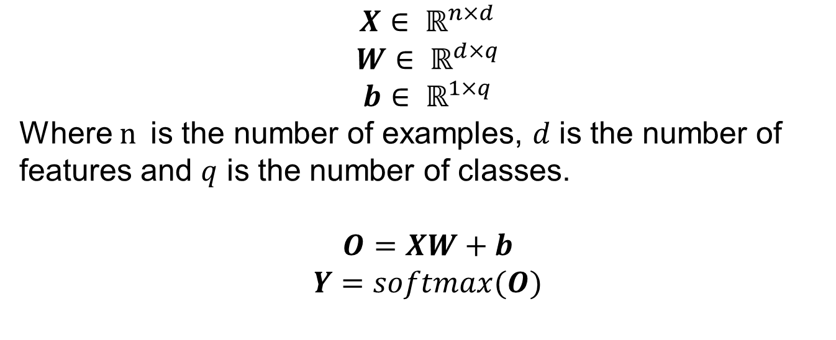
Vectorized Approach
$$X∈ ℝ^{n×d}$$
$$W∈ ℝ^{d×q}$$
$$b∈ ℝ^{1×q}$$
Where $n$is the number of examples, $d$ is the number of features and $q$ is the number of classes.
$$O=XW+b$$
$$Y=softmax(O)$$

Slide 13
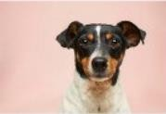
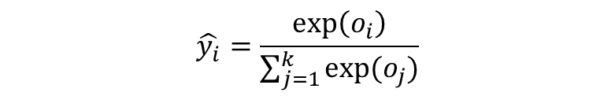
SoftMax - Example
Probabilities
Input Image
Model
Logit (O)
Softmax
Label
3.2
1.3
0.2
0.8
0.78
0.12
0.04
0.07
Classes
Dog
Cat
Bear
Tiger
$$\hat{y_{i}}=\frac{\exp\left(o_{i}\right)}{\sum_{j=1}^{k}{exp⁡(o_{j})}}$$
Figure taken from Web

Slide 14
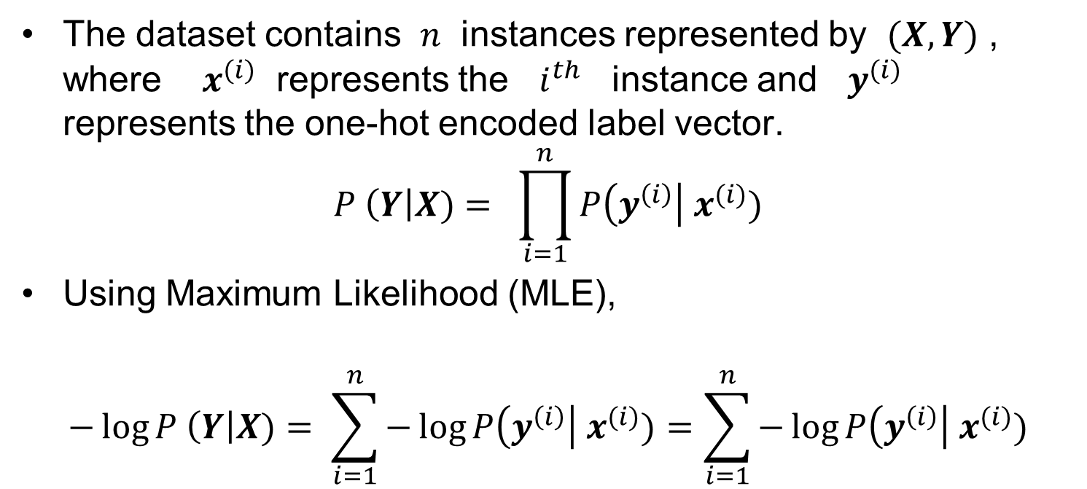
Log-Likelihood
The dataset contains $n$ instances represented by $(X,Y)$ , where $x^{(i)}$ represents the $i^{th}$ instance and $y^{(i)}$ represents the one-hot encoded label vector.
$$P \left(Y\right|X)= \prod_{i=1}^{n}{P\left(y^{\left(i\right)}\right| x^{(i)})}$$
Using Maximum Likelihood (MLE),
$$−\log{P \left(Y\right|X)}= \sum_{i=1}^{n}{−\log{P\left(y^{\left(i\right)}\right| x^{(i)})=\sum_{i=1}^{n}{−\log{P\left(y^{\left(i\right)}\right| x^{(i)})}}}}$$

Slide 15
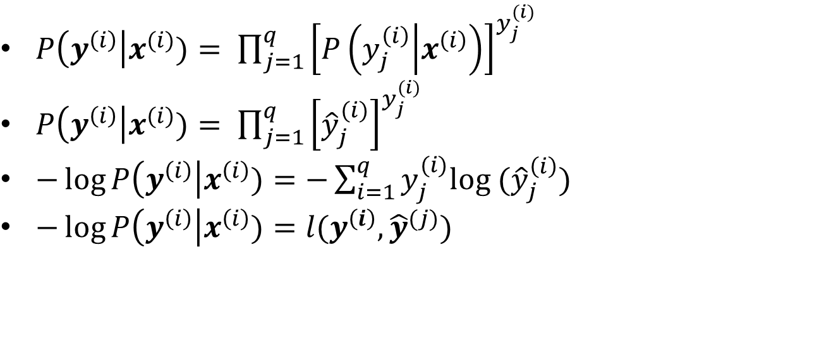
Loss Function
$P\left(y^{\left(i\right)}\right|x^{(i)})= \prod_{j=1}^{q}{{\left[P\left(y_{j}^{\left(i\right)} | x^{\left(i\right)}\right)\right]}^{y_{j}^{(i)}}}$
$P\left(y^{\left(i\right)}\right|x^{(i)})= \prod_{j=1}^{q}{{\left[{\hat{y}}_{j}^{(i)}\right]}^{y_{j}^{(i)}}}$
$−\log{P\left(y^{\left(i\right)}\right|x^{\left(i\right)})}=−\sum_{i=1}^{q}{y_{j}^{(i)}log ({\hat{y}}_{j}^{\left(i\right)})}$
$−\log{P\left(y^{\left(i\right)}\right|x^{\left(i\right)})}=l(y^{\left(i\right)},{\hat{y}}^{(j)})$

Slide 16
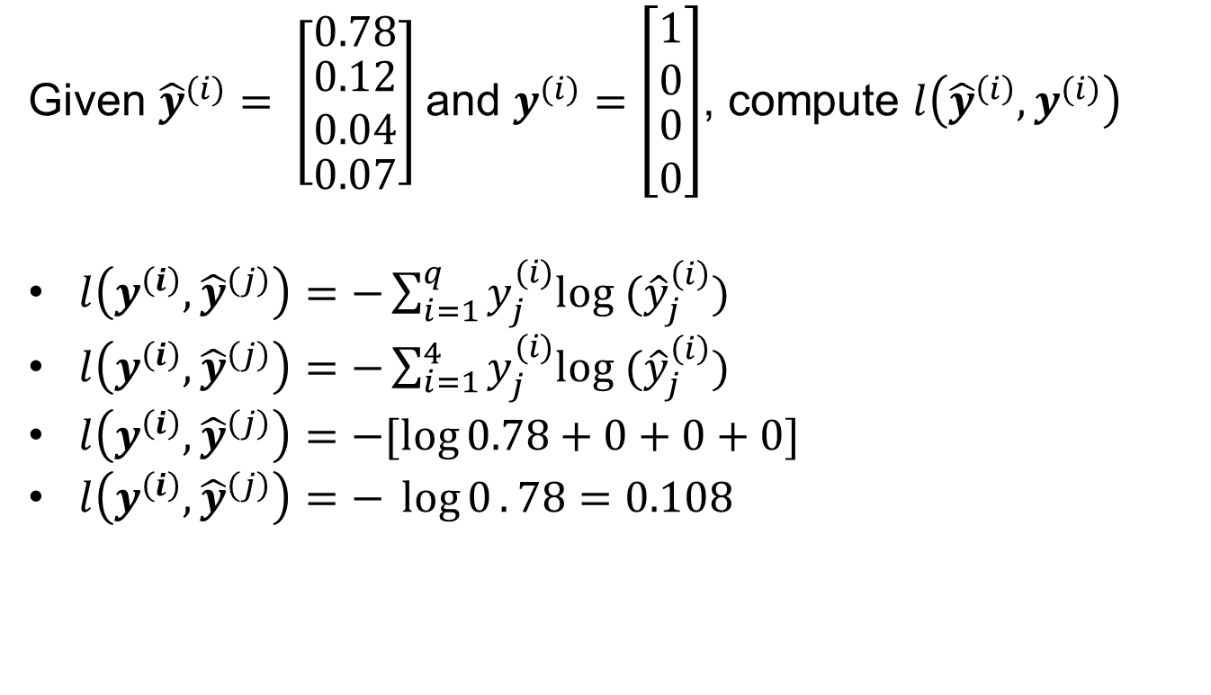
Cross Entropy Loss - Example
Given ${\hat{y}}^{(i)}= \left[\begin{matrix}0.78 \\ \begin{aligned}0.12 \\ 0.04\end{aligned} \\ 0.07\end{matrix}\right]$and $y^{(i)}=\left[\begin{matrix}1 \\ 0 \\ \begin{aligned}0 \\ 0\end{aligned}\end{matrix}\right]$, compute $l\left({\hat{y}}^{\left(i\right)},y^{(i)}\right)$
$l\left(y^{\left(i\right)},{\hat{y}}^{\left(j\right)}\right)=−\sum_{i=1}^{q}{y_{j}^{(i)}log ({\hat{y}}_{j}^{\left(i\right)})}$
$l\left(y^{\left(i\right)},{\hat{y}}^{\left(j\right)}\right)=−\sum_{i=1}^{4}{y_{j}^{(i)}log ({\hat{y}}_{j}^{\left(i\right)})}$
$l\left(y^{\left(i\right)},{\hat{y}}^{\left(j\right)}\right)=−[\log{0.78+0+0+0]}$
$l\left(y^{\left(i\right)},{\hat{y}}^{\left(j\right)}\right)=− \log{0}.78=0.108$

Slide 17
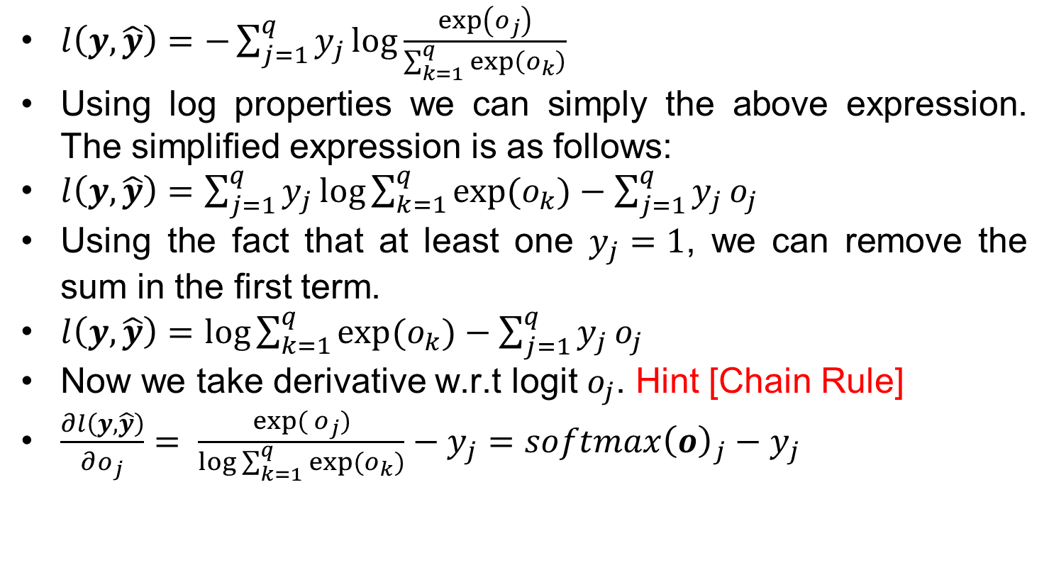
SoftMax and Cross-Entropy Loss
$l\left(y,\hat{y}\right)=−\sum_{j=1}^{q}{y_{j}\log{\frac{\exp\left(o_{j}\right)}{\sum_{k=1}^{q}{\exp\left(o_{k}\right)}}}}$
Using log properties we can simply the above expression. The simplified expression is as follows:
$l\left(y,\hat{y}\right)=\sum_{j=1}^{q}{y_{j}}\log{\sum_{k=1}^{q}{exp⁡(o_{k})}}−\sum_{j=1}^{q}{y_{j}}o_{j}$
Using the fact that at least one $y_{j}=1$, we can remove the sum in the first term.
$l\left(y,\hat{y}\right)=\log{\sum_{k=1}^{q}{exp⁡(o_{k})}}−\sum_{j=1}^{q}{y_{j}}o_{j}$
Now we take derivative w.r.t logit $o_{j}$. Hint [Chain Rule]
$\frac{∂l\left(y,\hat{y}\right)}{∂o_{j}}= \frac{\exp{( o_{j})}}{\log{\sum_{k=1}^{q}{exp⁡(o_{k})}}}−y_{j}=softmax{\left(o\right)}_{j}−y_{j}$

Slide 18
References
https://d2l.ai/chapter_linear-classification/index.html

